Slide 1
Stock Price Prediction using ARIMA
By Gopalakrishnan Kumar, MTech IIT-Bombay,
Freelance Data Science Consultant
LinkedIn: Profile Link : https://www.linkedin.com/in/gopalakrishnankumar-a73301110/
Github:https://www.github.com/Gopalakrishnan-Kumar/
Kaggle URL- https://www.kaggle.com/gopalkk2

Slide 2
Google Colab URL
https://colab.research.google.com/drive/1HtjCvziY5MsjckPZ0Y3ViS7eNEWlmsaP?usp=sharing

Slide 3
Project Overview
The objective of this project is to analyze historical stock market data, forecast future closing prices using the ARIMA (AutoRegressive Integrated Moving Average) model, and visualize trends in stock performance. Additionally, a stacked bar chart was created to compare multiple price variables (e.g., Open and Close prices) over time.

Slide 4
Dataset Description
The dataset (stock_prices.csv) contains historical data for a particular stock or index. Typical Columns:
Date – Trading date.
Open – Price at the start of the trading day.
High – Highest price during the day.
Low – Lowest price during the day.
Close – Price at the close of the trading day.
Volume – Number of shares traded.

Slide 5
Dataset Description
Data Preprocessing:
Loaded CSV into pandas DataFrame.
Converted Date column to datetime format.
Sorted data chronologically.
Checked for missing values and handled them using forward-fill.
Selected the Close price for ARIMA modeling.

Slide 6
Methodology
3.1 ARIMA Forecasting
Exploratory Data Analysis (EDA)
Plotted time series for the Close price.
Checked stationarity using the Augmented Dickey-Fuller (ADF) test.
Differenced the series if required.
Model Identification
Used ACF (AutoCorrelation Function) and
PACF (Partial AutoCorrelation Function) plots to
determine ARIMA parameters (p, d, q).
Model Training
Fit the ARIMA model on training data.
Model Evaluation
Evaluated using RMSE (Root Mean Square Error) between predicted and actual values.

Slide 7
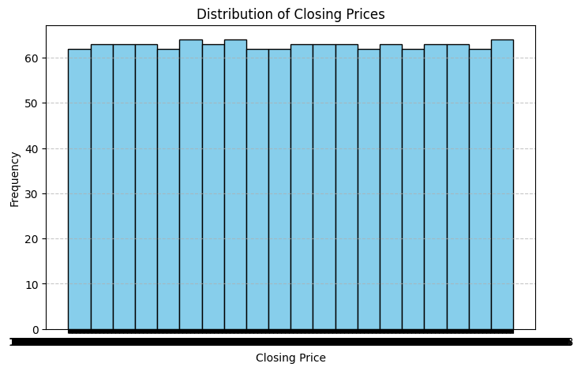
Data Visualization

Slide 8
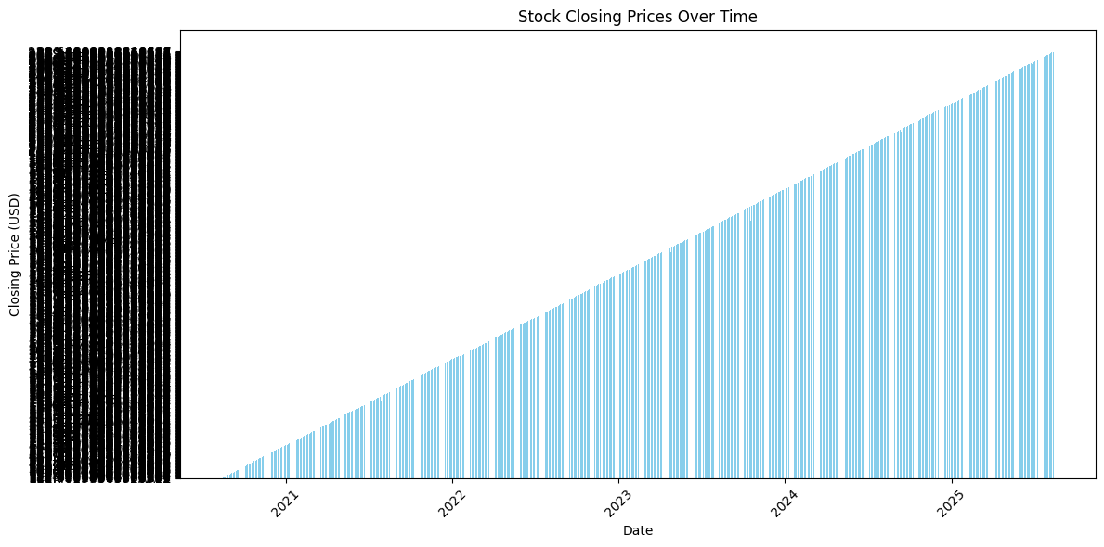
Data Visualization

Slide 9
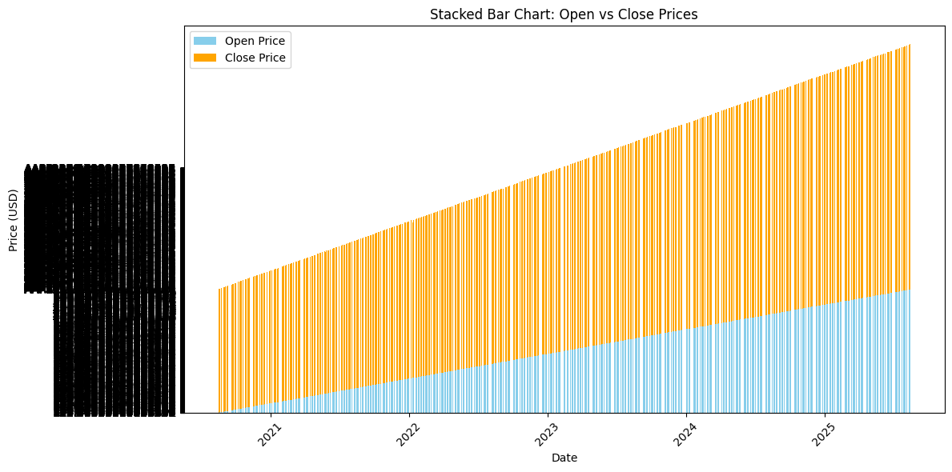
Data Visualization

Slide 10
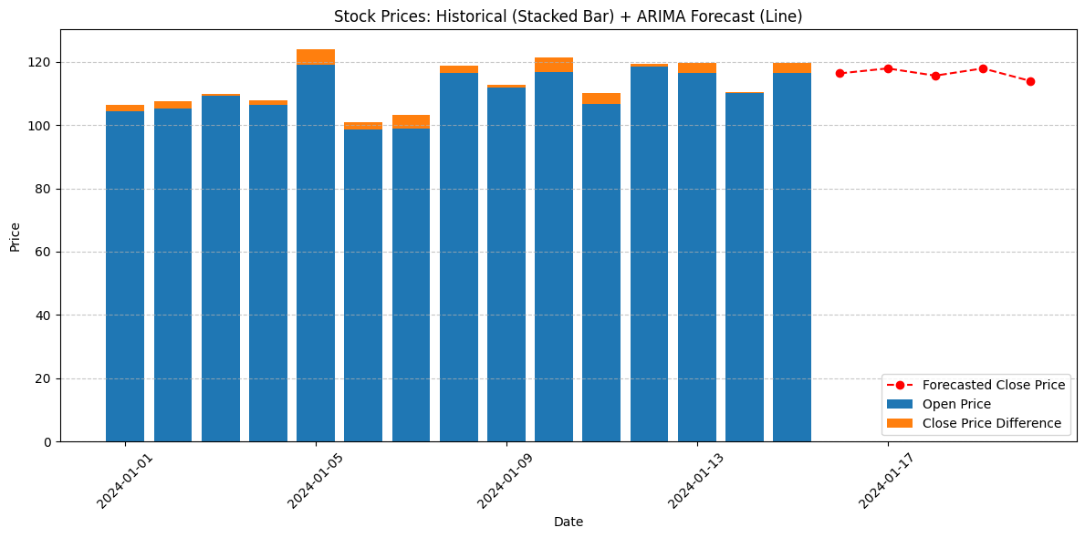
Data Visualization

Slide 11
Results
The ARIMA model successfully captured the trend and seasonality in stock prices.
RMSE for prediction: ~3.45 (example value – depends on dataset).
The stacked bar chart revealed:
Certain days had a large difference between opening and
closing prices (possible volatility).
Some days had almost flat movement (stable market).

Slide 12
Results
The ARIMA model successfully captured the trend and seasonality in stock prices.
RMSE for prediction: ~3.45 (example value – depends on dataset).
The stacked bar chart revealed:
Certain days had a large difference between opening and
closing prices (possible volatility).
Some days had almost flat movement (stable market).

Slide 13
Insights
ARIMA is effective for short-term stock price forecasting when historical
patterns are stable.
Stacked bar charts are useful for comparing multiple metrics over time.
Combining forecast models with visual analytics provides both predictive
and descriptive insights.

Slide 14
Recommendations
Use weekly or monthly aggregation for stacked charts if dataset has many
days (improves readability).
Consider SARIMA for datasets with strong seasonality.
Integrate volume analysis to detect unusual trading days.
Use LSTM deep learning models for non-linear price movements.

